Slide 1
F# 101
Keith Dahlby
Inetium
http://solutionizing.net/
@dahlbyk

Slide 2
Twitter
#IowaCodeCamp
#IACCFS
License: (CC) BY–NC by Keith Dahlby — keith@solutionizing.net

Slide 3
Who am I?
Iowa Native
Iowa State University
Cedar Rapids
SharePoint
Inetium
Language Geek

Slide 4
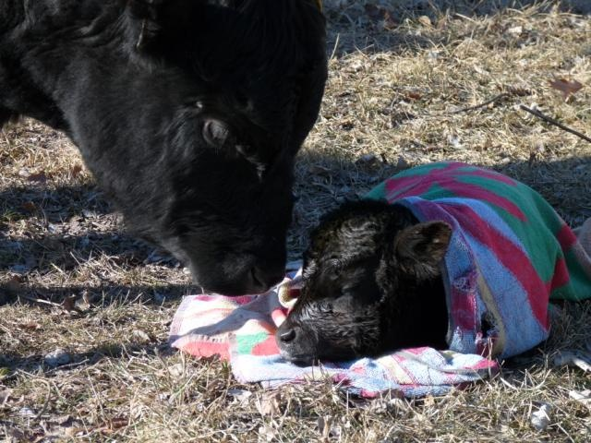
Got Milk?
© Greg Wilson – http://tinyurl.com/GregWilsonCow

Slide 5
x = x + 1

Slide 6
Functional Programming
First Class Functions
Higher-Order Functions
No Shared State
No Side Effects
Immutable Data Structures
Recursion

Slide 7
What is F#?
YADNL (Yet Another .NET Language)
CLR 2.0
Functional – Superset of OCaml
Imperative
Object-Oriented
Statically Typed

Slide 8
F#
Demo

Slide 9
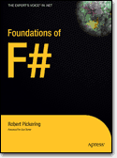
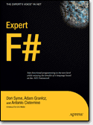

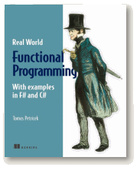
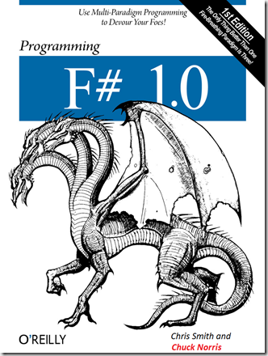
Books

Slide 10
Resources
F# Developer Center
http://www.fsharp.net/
hubFS: THE place for F#
http://cs.hubfs.net/
My Blog (Mostly SharePoint)
http://solutionizing.net/
keith@solutionizing.net
@dahlbyk

